Slide 1
Machine Learning Final Project
Harry Vellios

Slide 2
Contents
Analysing the Data
Visualising the data
Question 1
Question 2
Question 3
Question 4

Slide 3
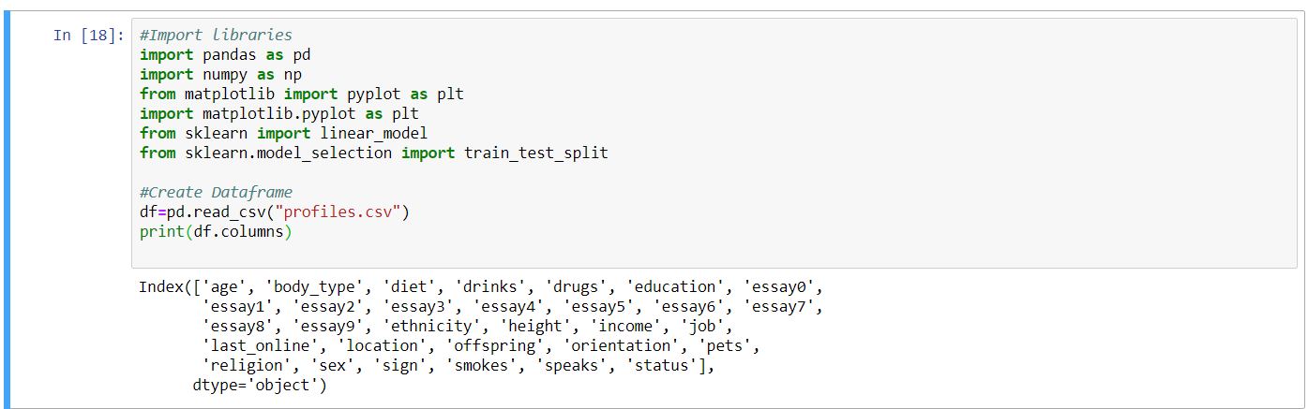
Analysing the Data
Introduction
Viewing Columns
In order to successfully complete this project, it is crucial to fully understand the elements it consists of-the data frame. To do this, I will use panda commands to understand the columns it consists of and the data patterns in each of them respectively. Furthermore, visualisation of data will be used to make trends clearer.

Slide 4
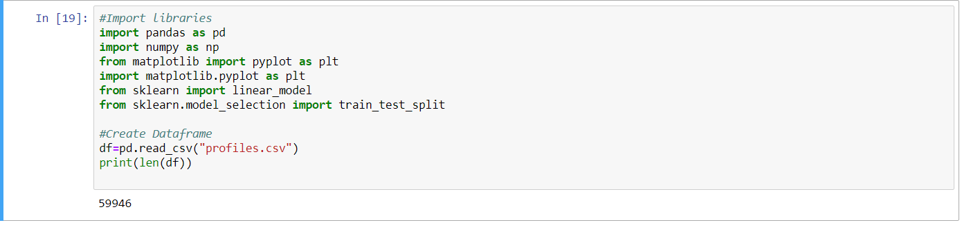
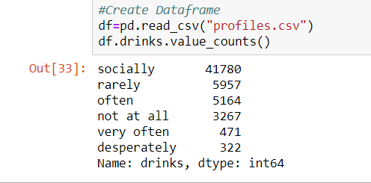
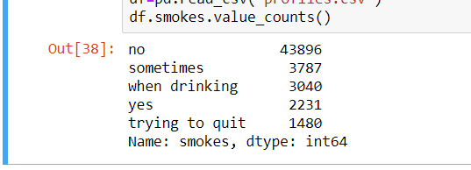
Exploring Data
Firstly, it was important to understand the general structure of the data frame. Running simple commands such as .columns, .head(),.value_counts() and .describe() made this possible. Examples of some outputs that were analysed can be seen above. With this information, it is now possible to create graphs to further analyse the distribution of the data.

Slide 5
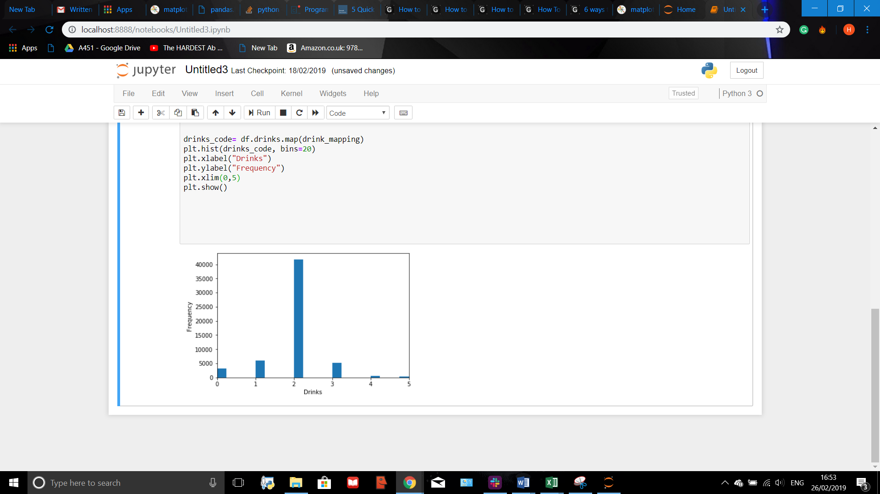
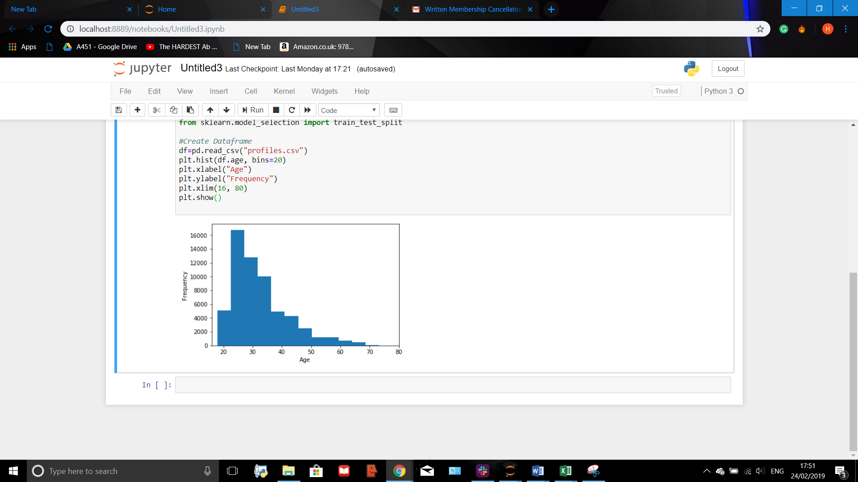
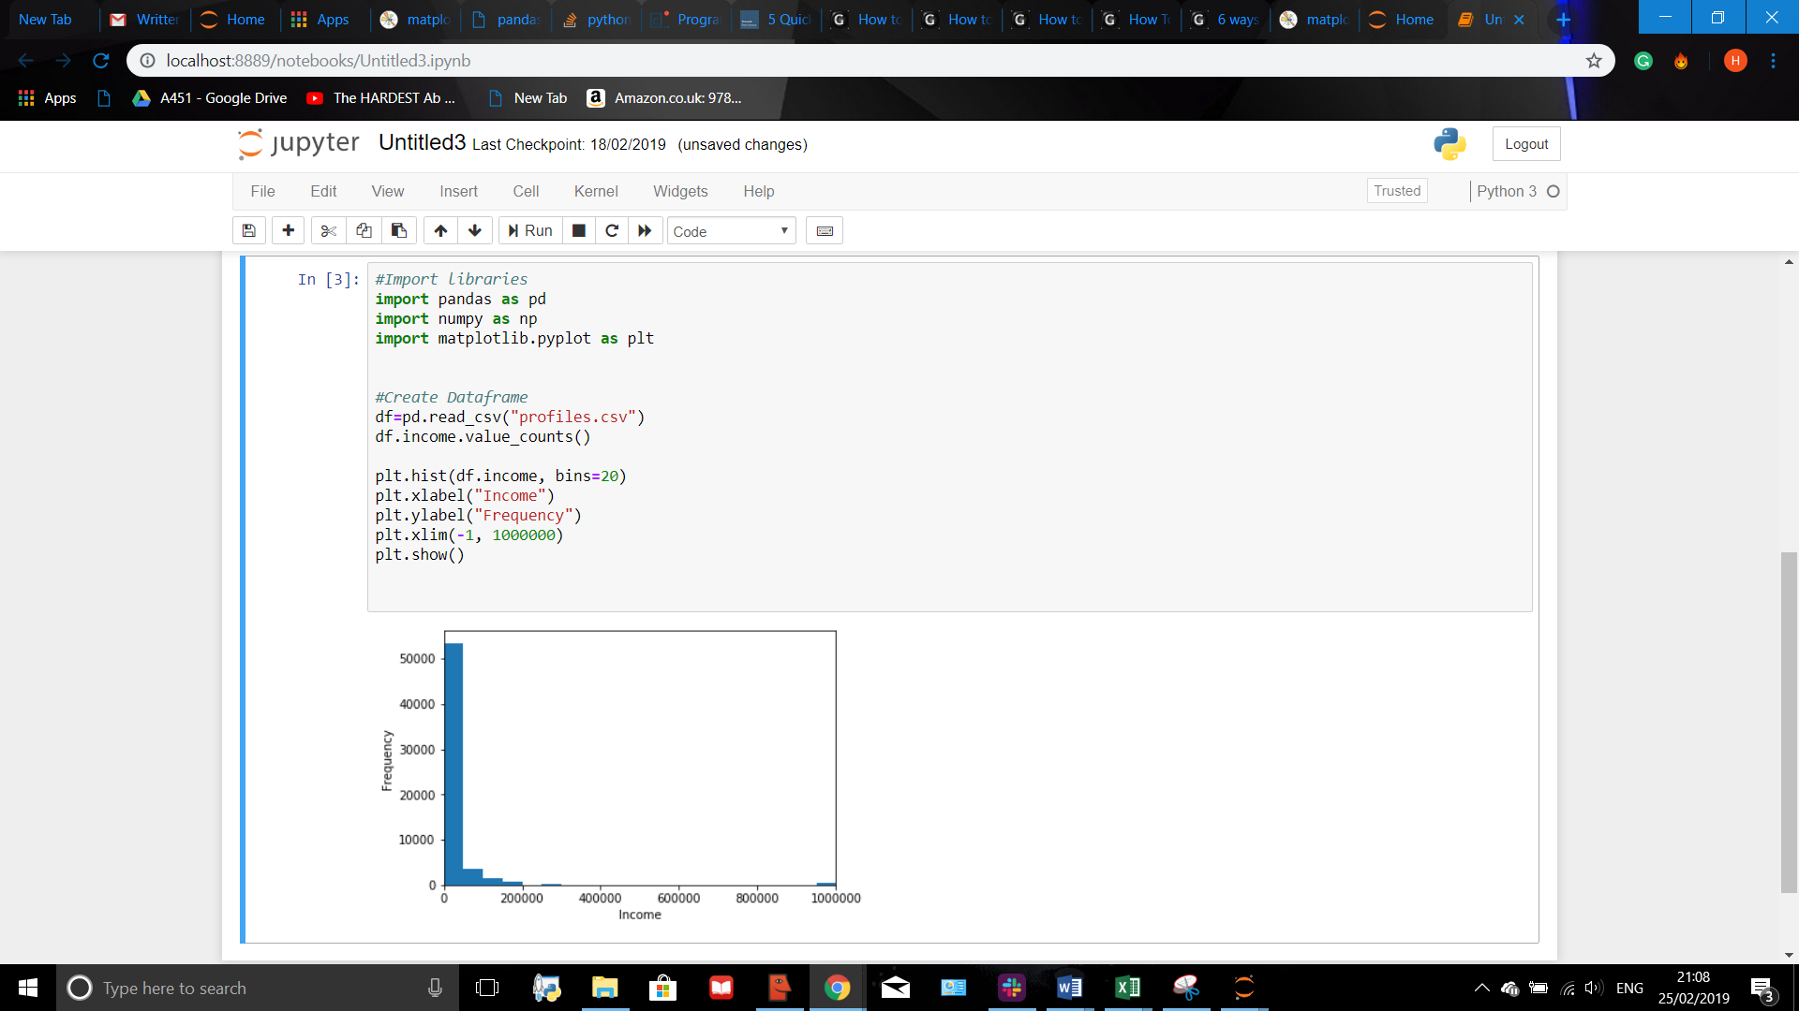
Visualising the Data
Before formatting any questions, it is possible to spot trends in the data which will make the modelling process much easier. We can do this by visualising the data. On the right are some examples of this process being undertaken.

Slide 6
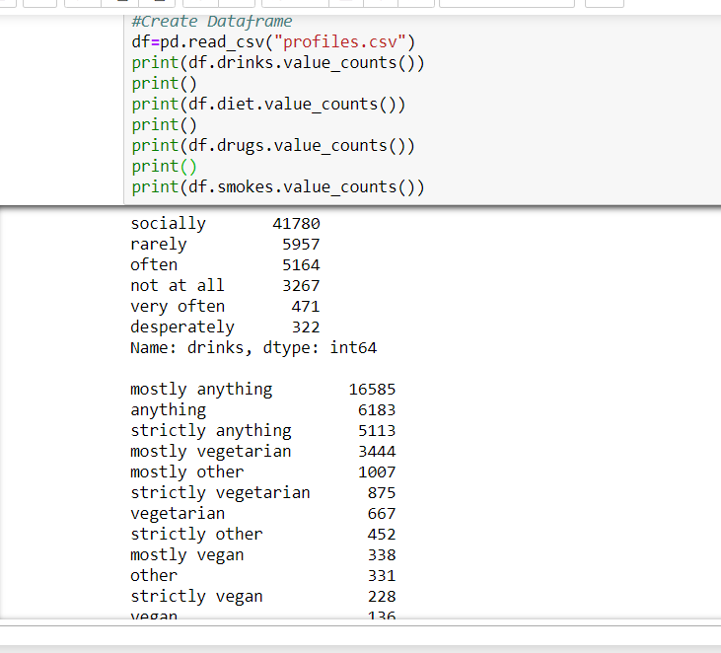
Question 1
The Question
Analysing Inputs of Data
Is there a trend between dangerous lifestyle choices like drinking and doing drugs affect the income of an individual?

Slide 7
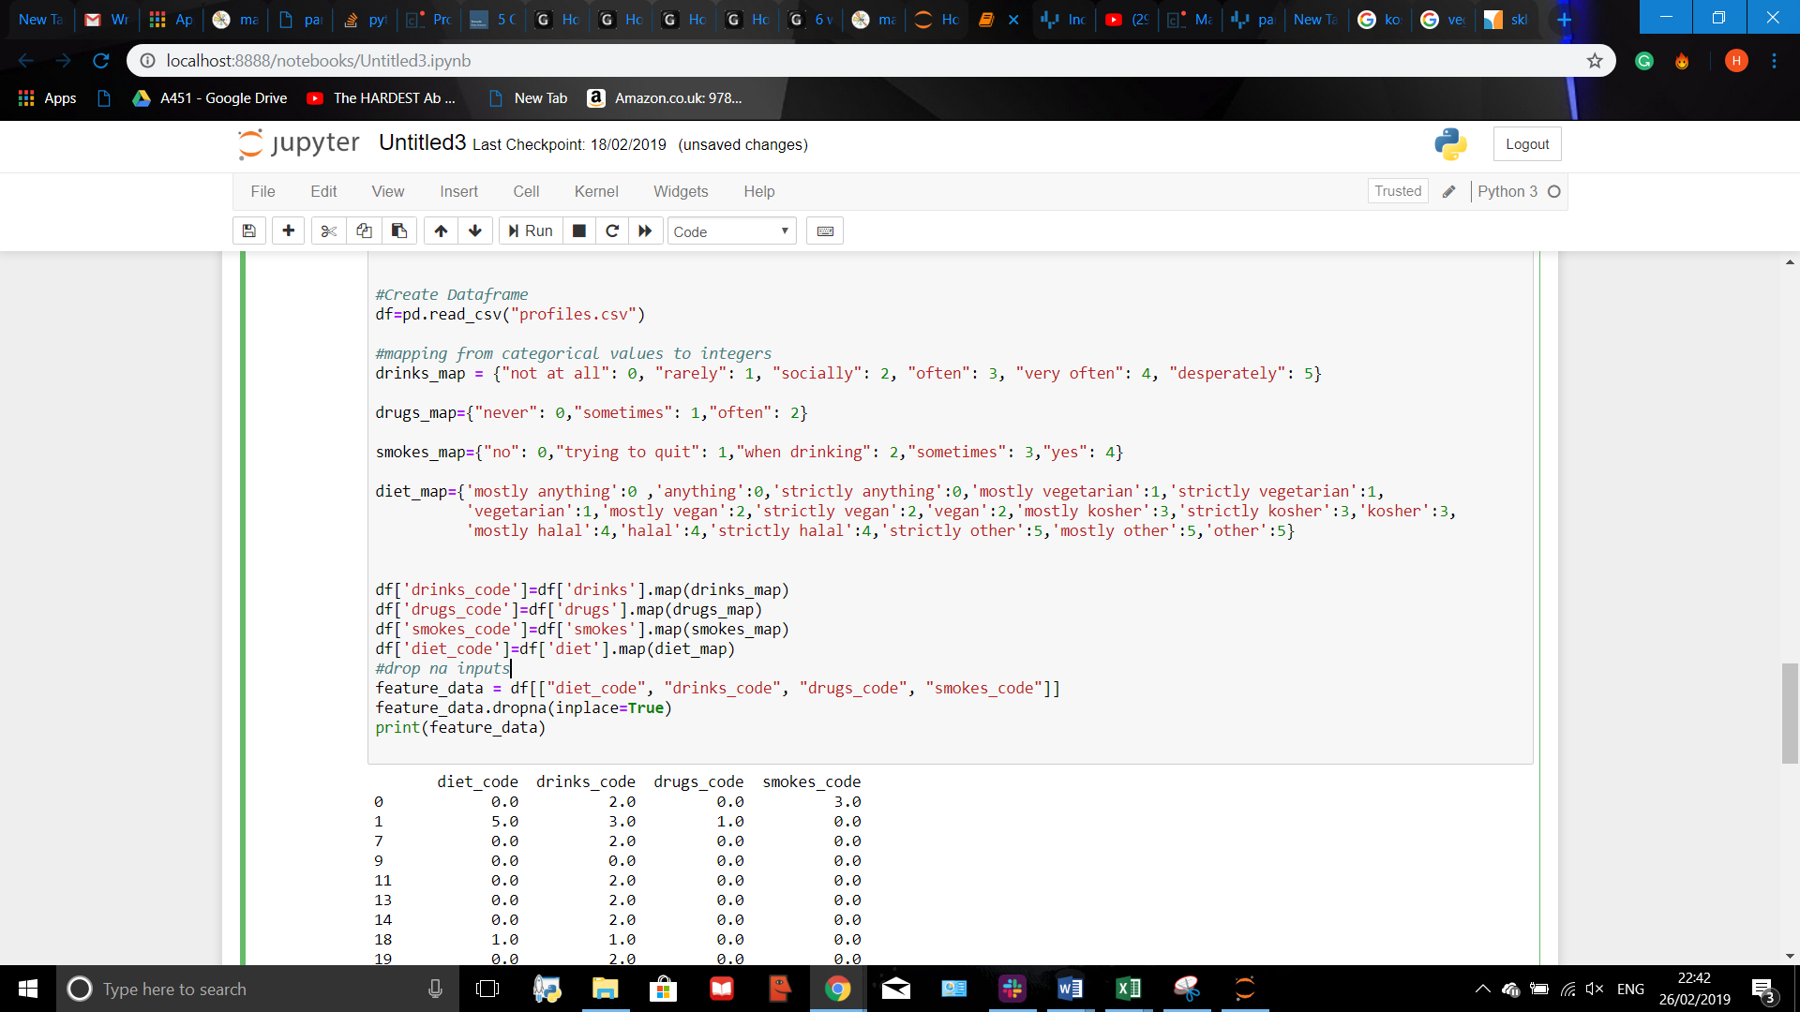
Question 1
Mapping the data
Most data used is in string form. In order for it to be useful in making a linear regression model, it needs to be in integer form. To do this, new columns where created into the data frame, which contain numerical mappings of string data.
Map variables where made first, containing the mapping values of all the possible inputs for the columns ‘drugs’,’ smokes’, ’diet’ and ‘drinks’. These values where found by running the ‘.value_counts()’ attribute.
Then, the columns ‘drinks_code’,’drugs_code’,’smokes_code’ and ‘diet_code’ where made using the code on the left.

Slide 8
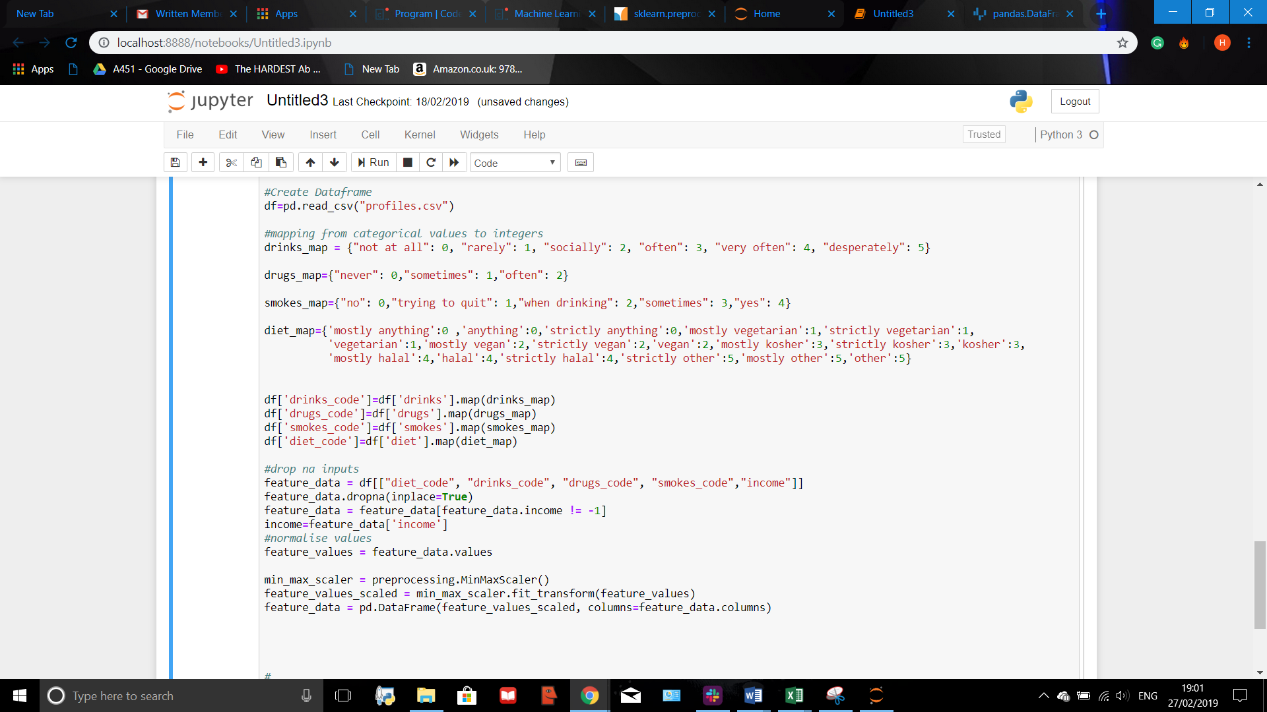
Editing Data and Normalising
In order for all parameters to affect the dependent value equally, they need to be normalised. This is because each of them has its own individual range it acts upon.
Min Max normalisation was used.

Slide 9
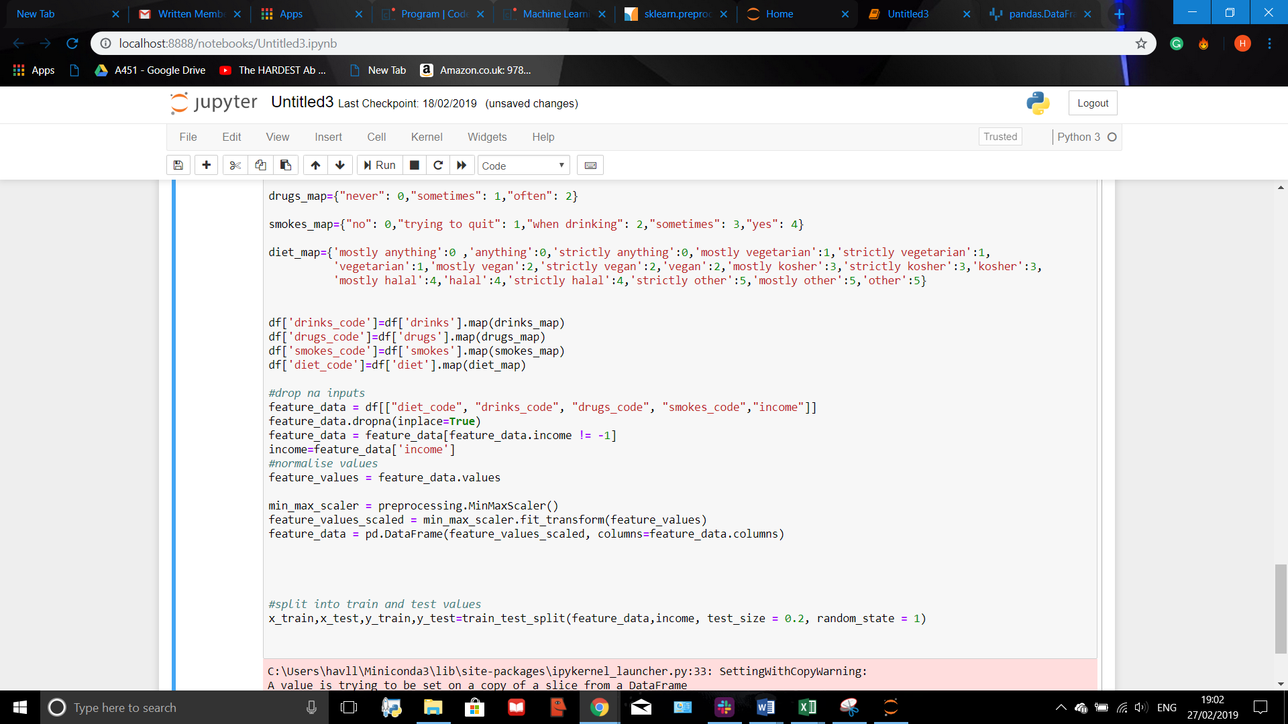
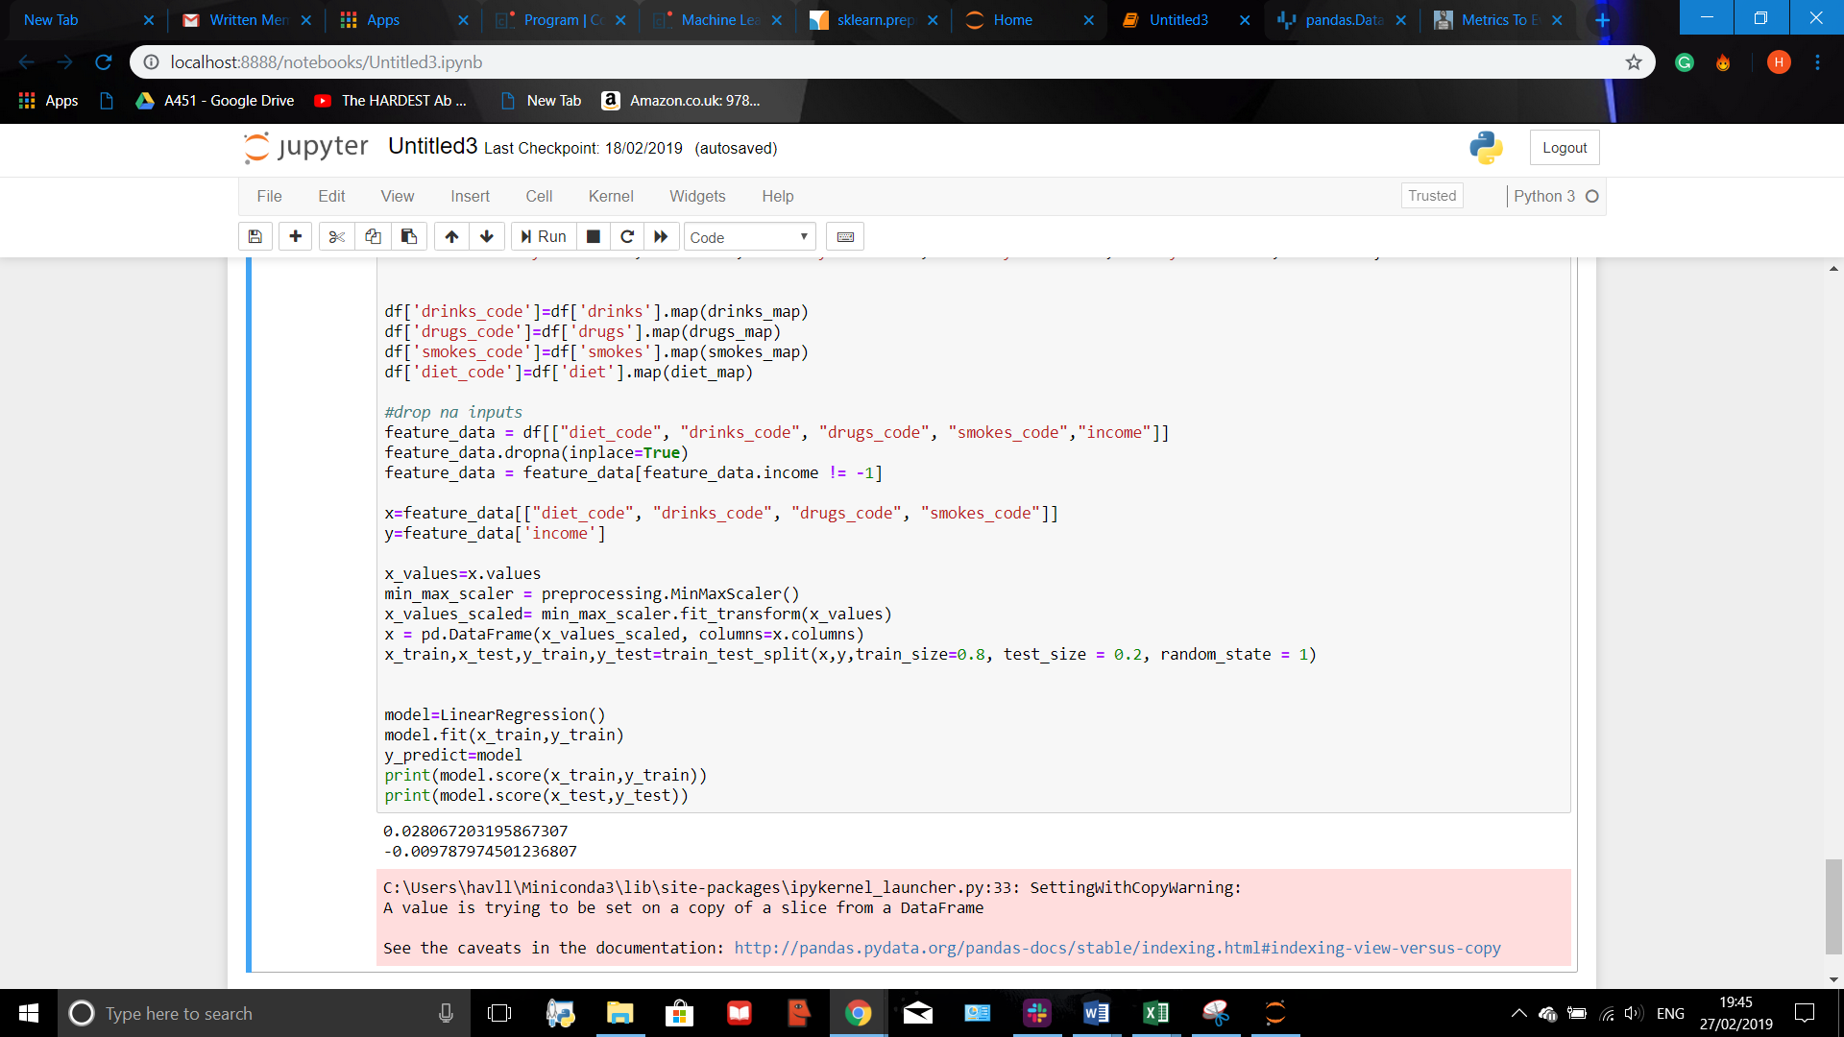
Question 1
Splitting into Train and Test Sets
Making and Running the Model

Slide 10
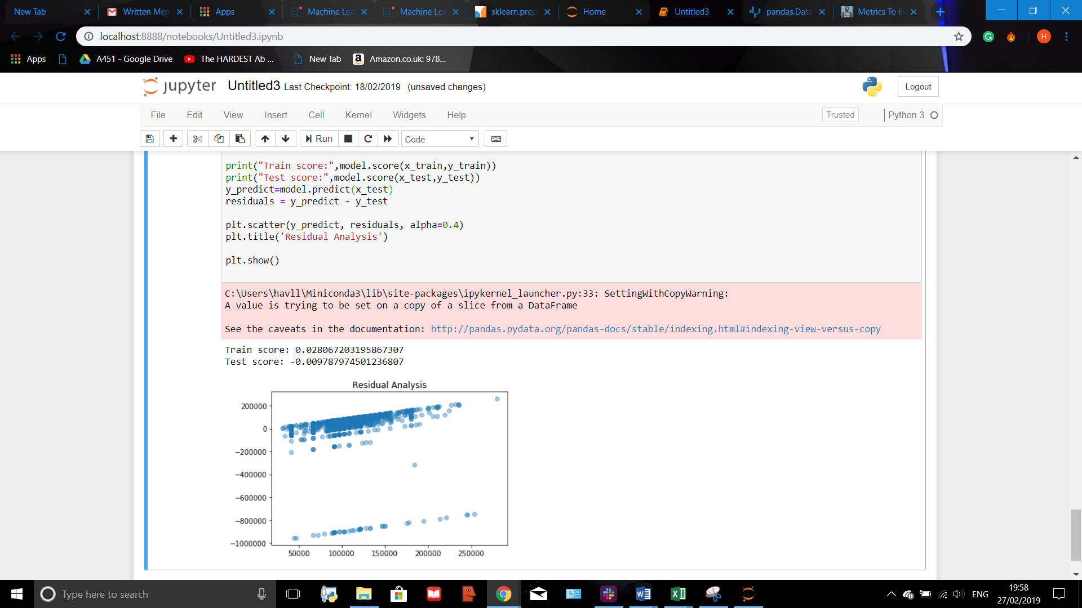
Residual Analysis
The linear regression model produced is extremely inaccurate. AS there is a big difference between the test and the train R^2 value, we can deduce that something is wrong inside the model. In order to attempt to fix this, a residual analysis visualisation can be produced to attempt to spot the problem.

Slide 11
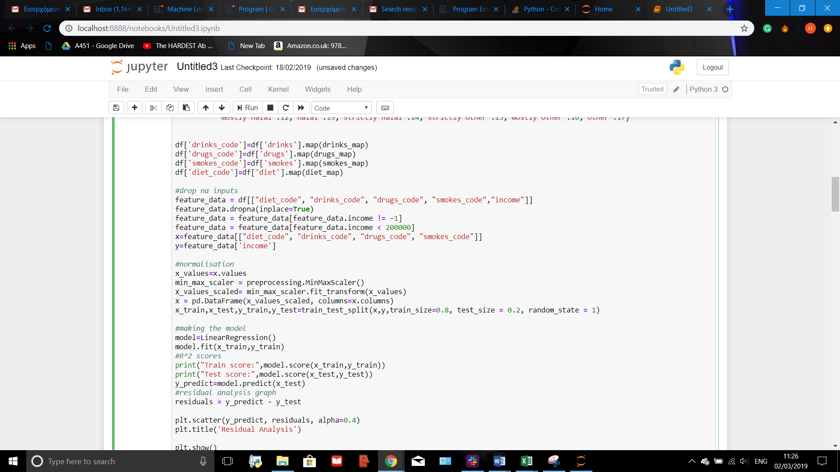
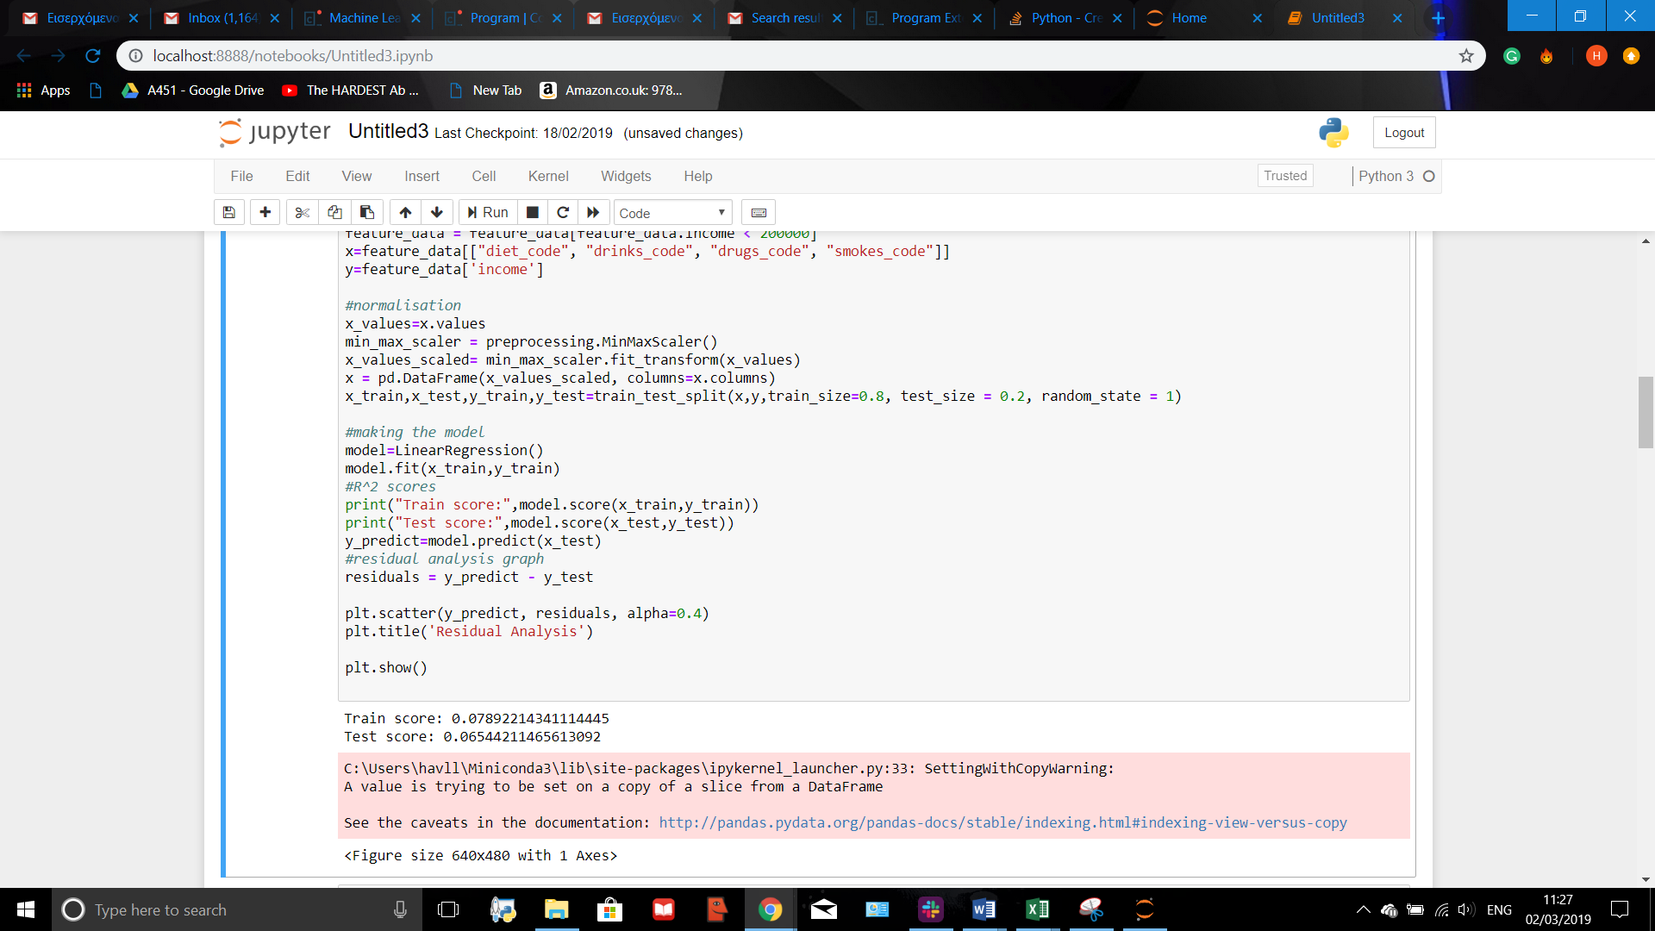
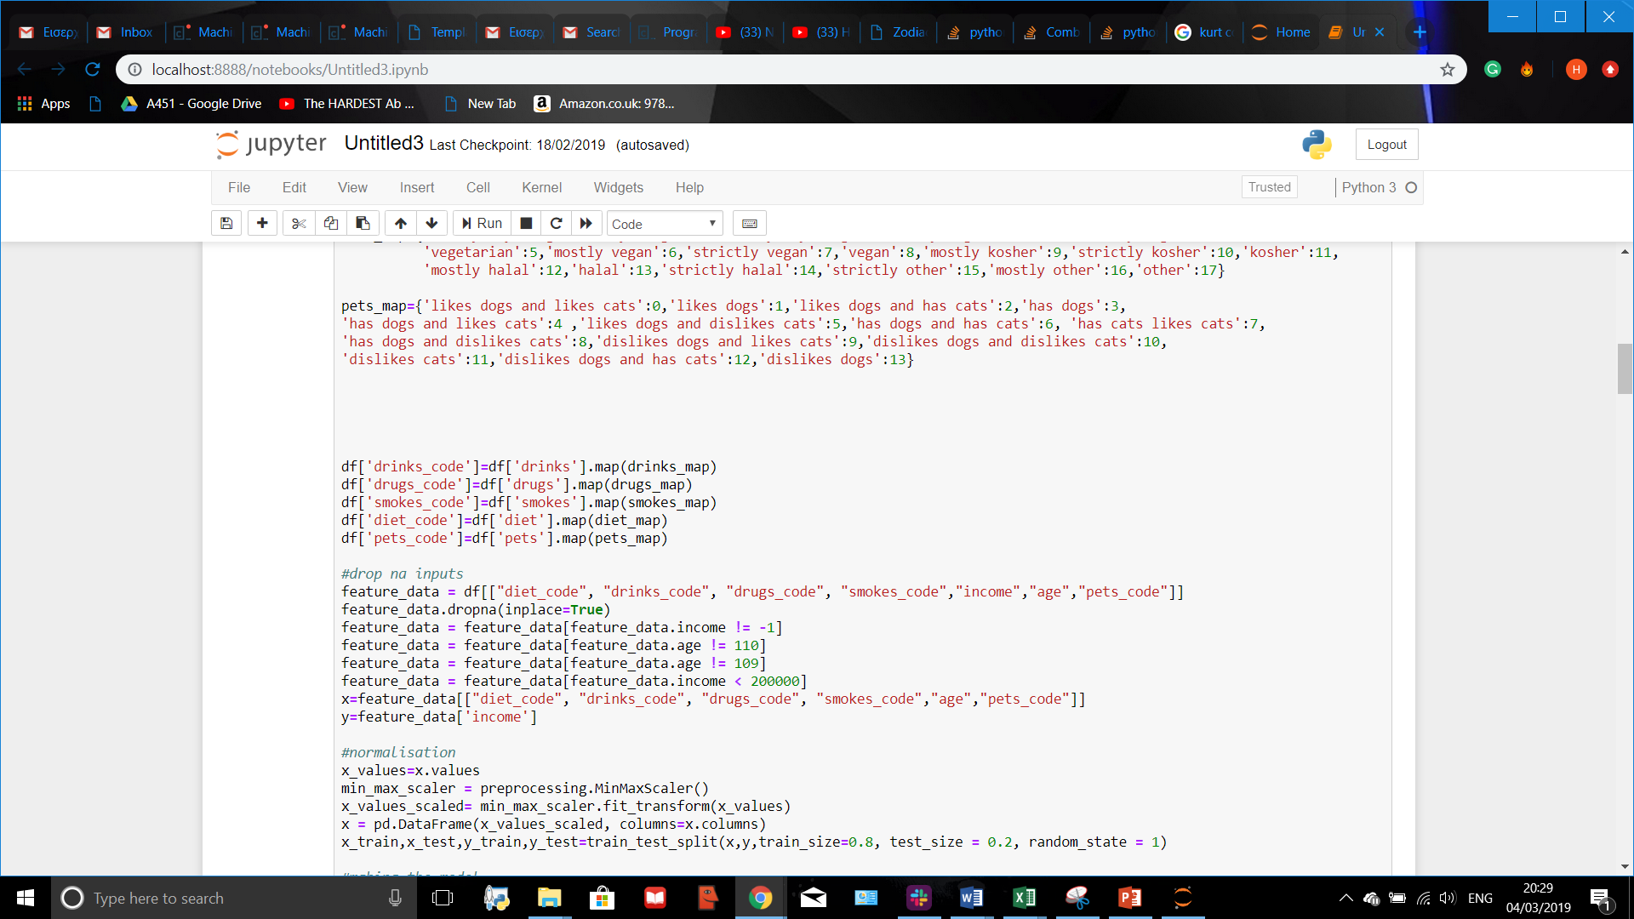
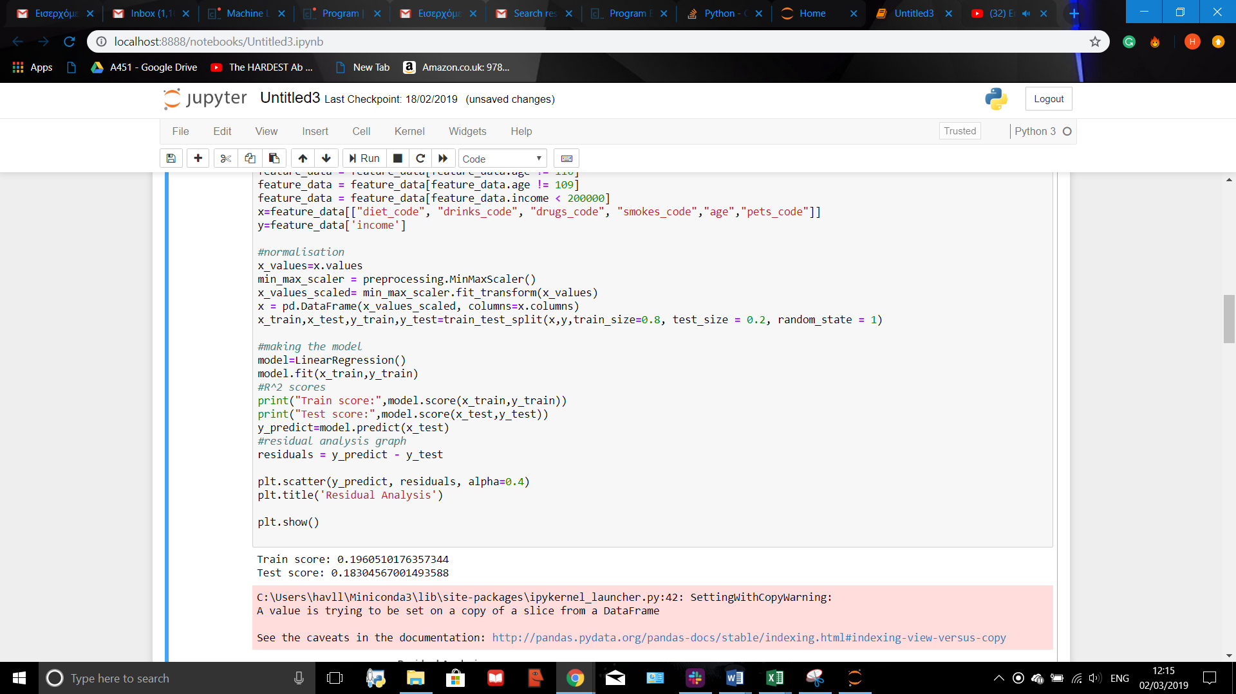
Fixing the Model
It can be seen that there are some outliers. When reanalysing the data, it can be seen that there are some extreme values in the ‘income’ column. Removing them will greatly improve the model.
Furthermore, adding more parameters allows for a better linear regression model as we increase the data it is made upon. This also was done to improve it
It can be seen that the model greatly improves in accuracy when outliers are removed
When adding a new parameter(which has nothing to do with out initial question) the model’s accuracy improves drastically

Slide 12
Question 1-Conclusion
When running the model, it was quite clear that there was not a clear correlation between lifestyle choices and income. This was due to a very low R^2 value being produced.
To validate that the reason for this wasn’t that the model was faulty, a new parameter was added. This more than doubled the R^2 value.
The model was easy to run, having a very fast runtime.
The difficulties arose when trying to improve the model and having to identify and eliminate outliers in the input data.This is because this required a careful analysis of the dataframe.
Part of the inaccuracy of the model could be due to dishonesty of individuals when answering potentially sensitive questions to do with dangerous lifestyle choices and even income.
It could also be because linear regression wasn’t a suitable model to use to represent the trend I was attempting to examine.

Slide 13
Question 2
The Question
Examination of Techniques used
Could a different Regression technique provide a more accurate model for Question 1?
Question 2 will attempt to build upon the code used in Question 1.The parameters used and the new columns introduced in the dataframe will be identical.However, the model used will be different, and it the effect of this which will be attempted to be analysed.

Slide 14
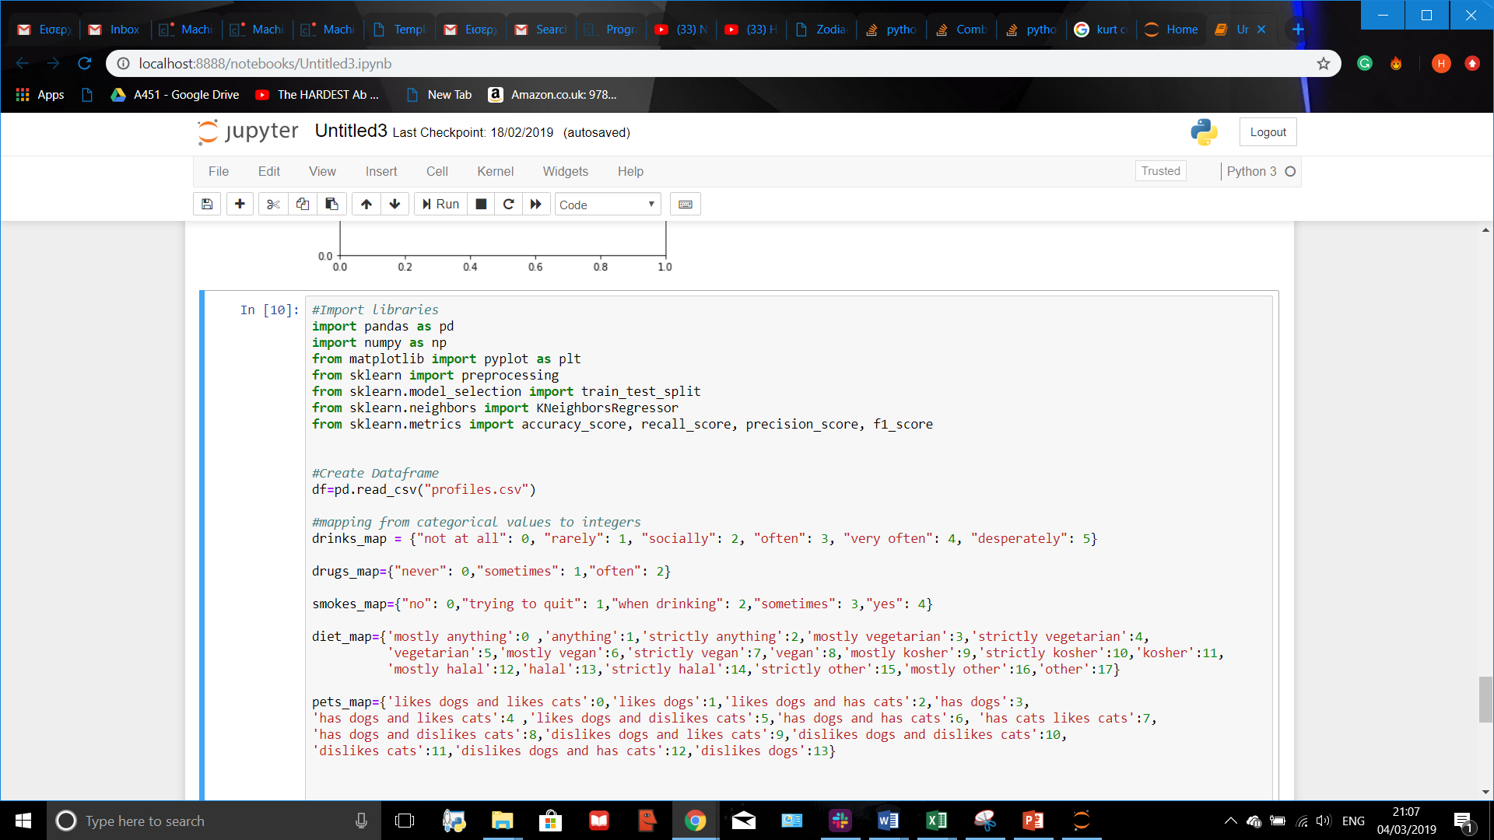
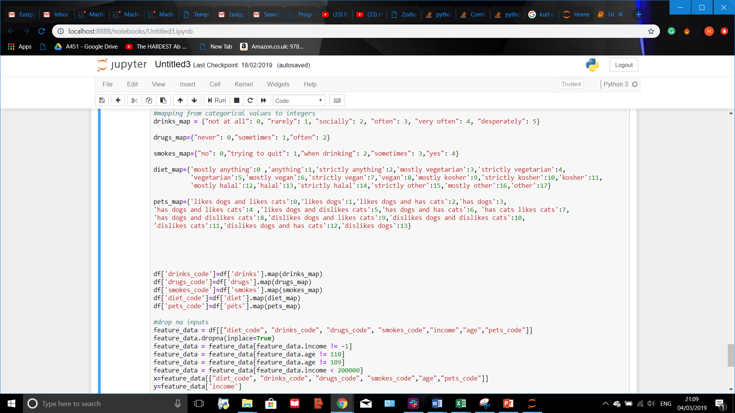
Importing model from sklearn
All the similar code

Slide 15
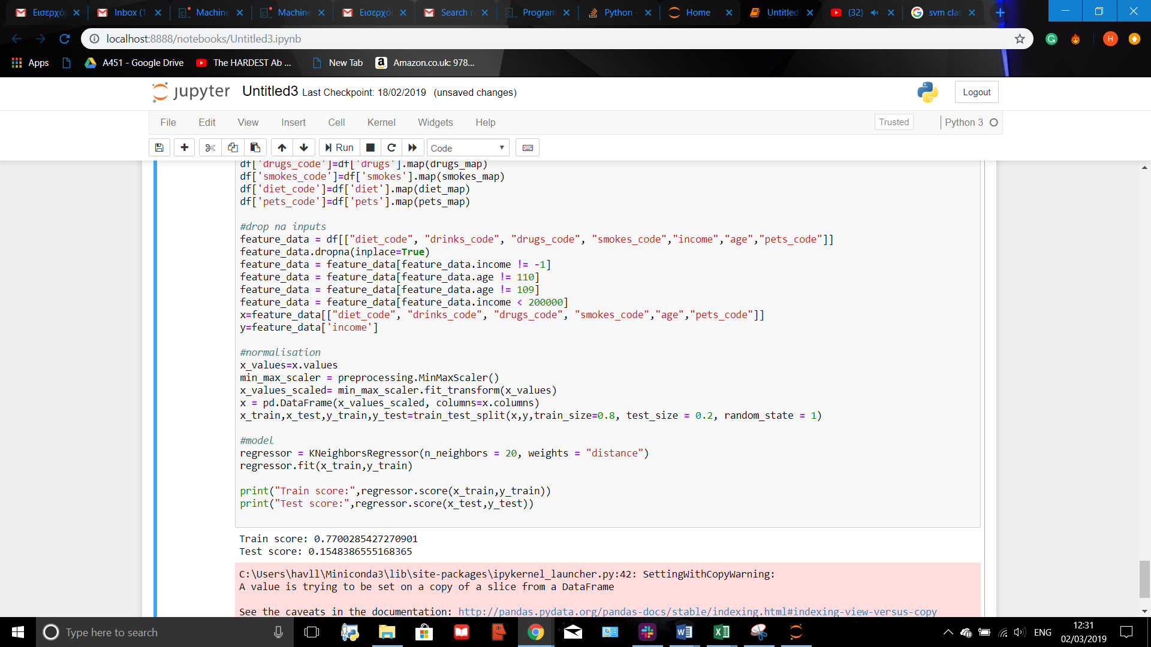
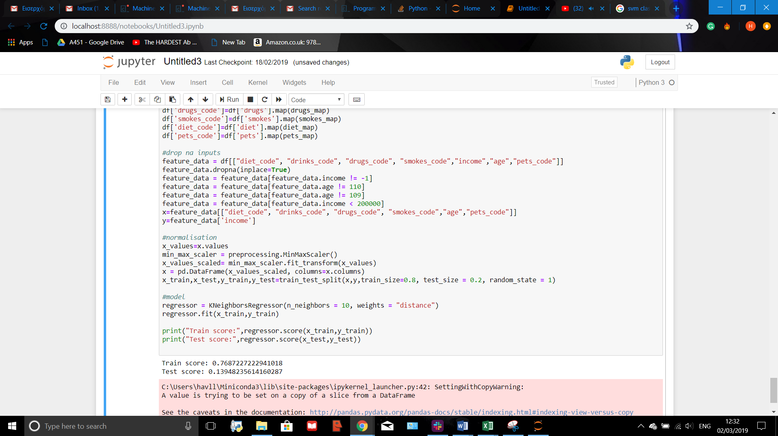

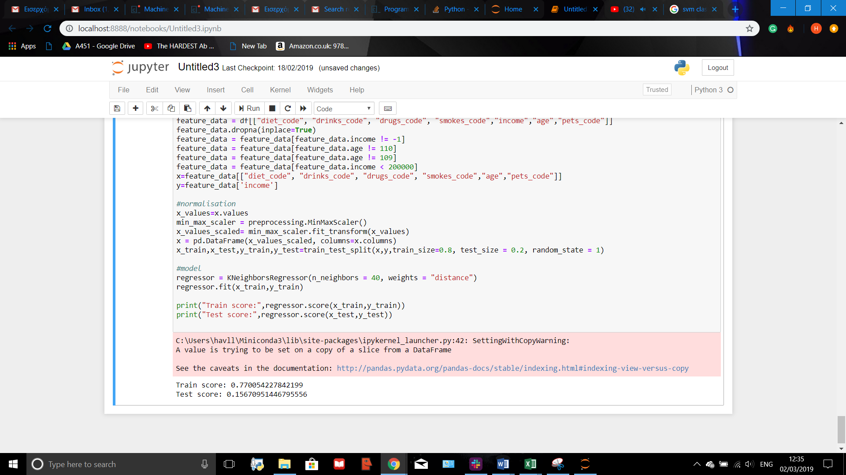
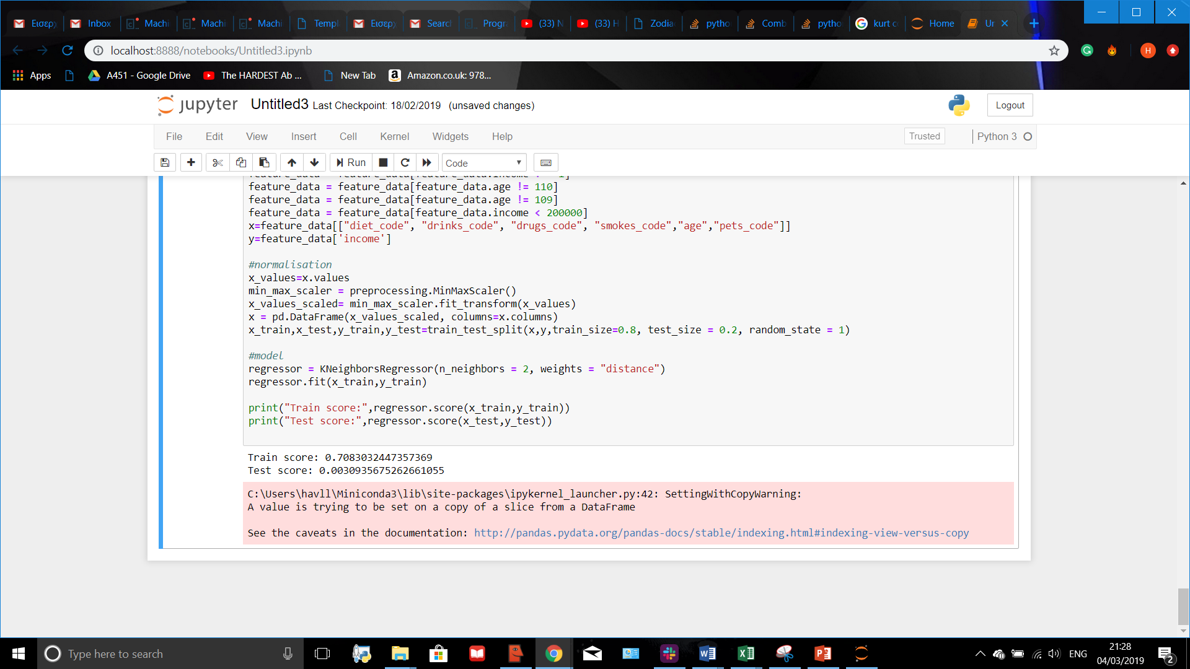
Making the model
When running the model, the difference between the test and train R^2 value is very high. This was assumed to be due to a wrong k value used.
A trial and error technique was used in order to obtain a more suitable value for k. K=40 appeared to be the best out of the ones tested, but overfitting was still clearly visible.
Examples of different values of k used to run the model.

Slide 16
Question 2-Conclusion
The model wasn’t very successful. Overfitting still appeared even after multiple attempts to decrease it by using a large range of k values.
In order to improve the model, a more efficient method of finding the most appropriate value for k could be used, like cross validation.
KmeansRegression is longer to use than Linear Regression due to the existence of the k value, and its runtime was longer, making it a harder Machine Learning Technique.

Slide 17
Question 3
The Question
The Model
Do observable traits like height, body type and age affect the job an individual has?
As the column job has discrete values, a classification technique will be used to model this correlation. An SVC classifier will be used

Slide 18
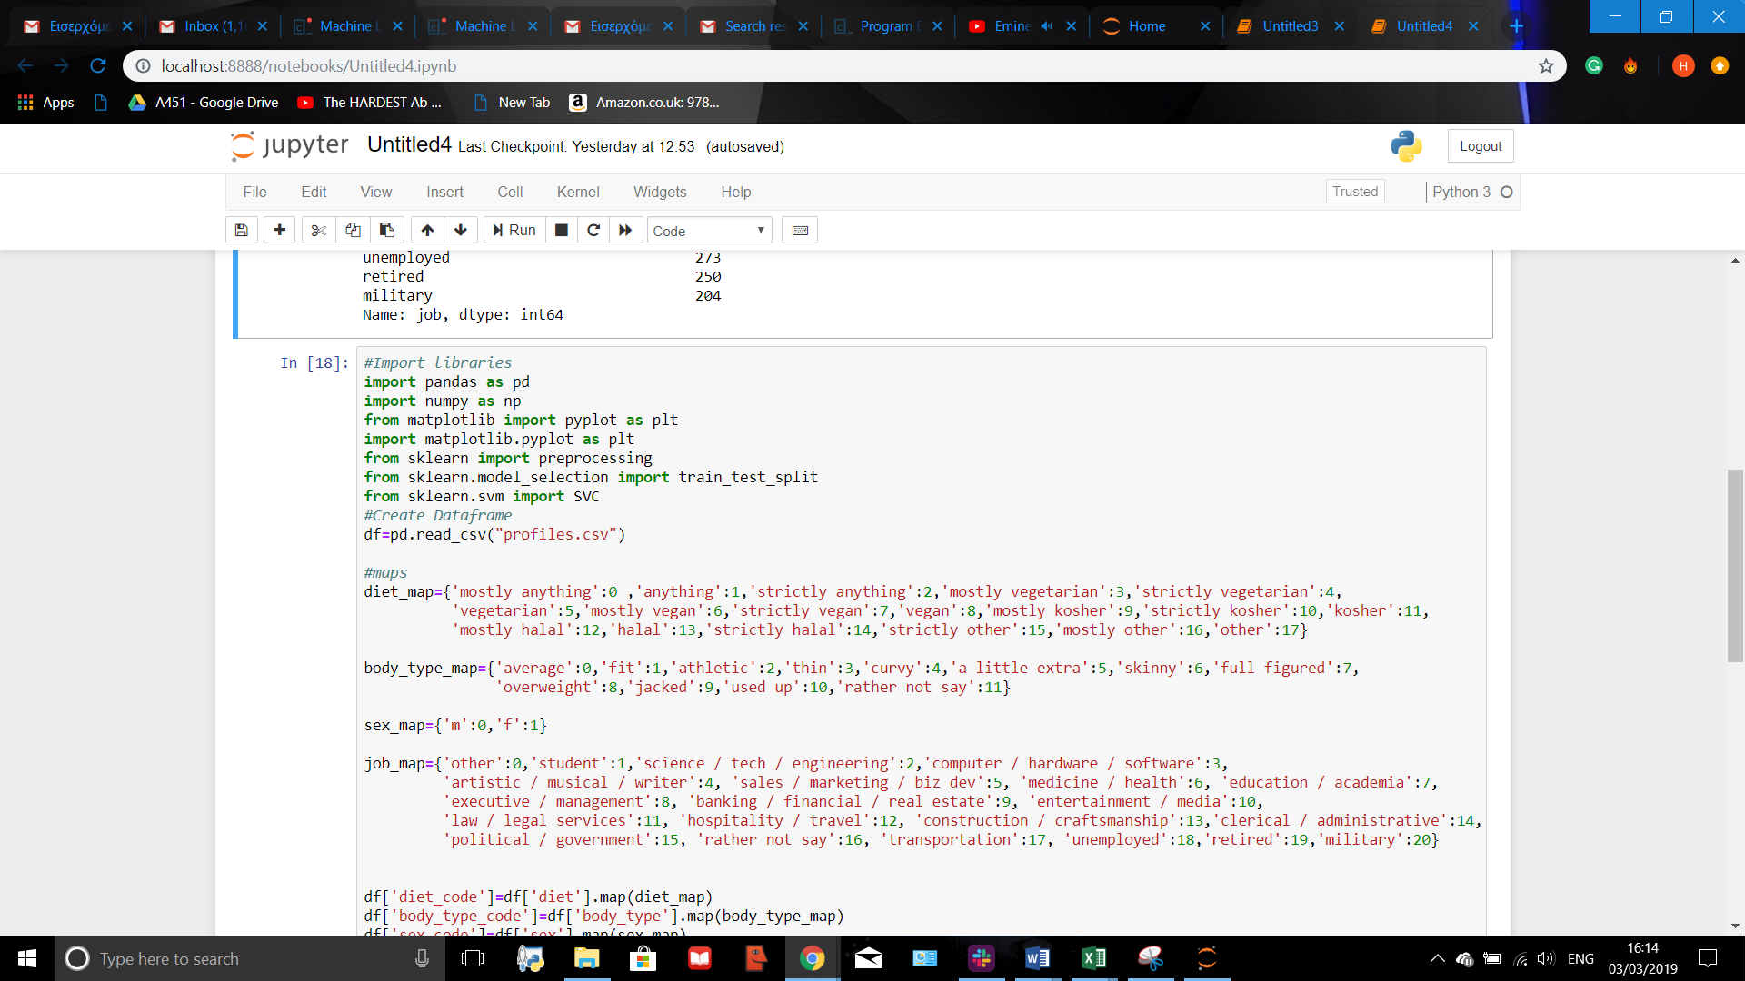
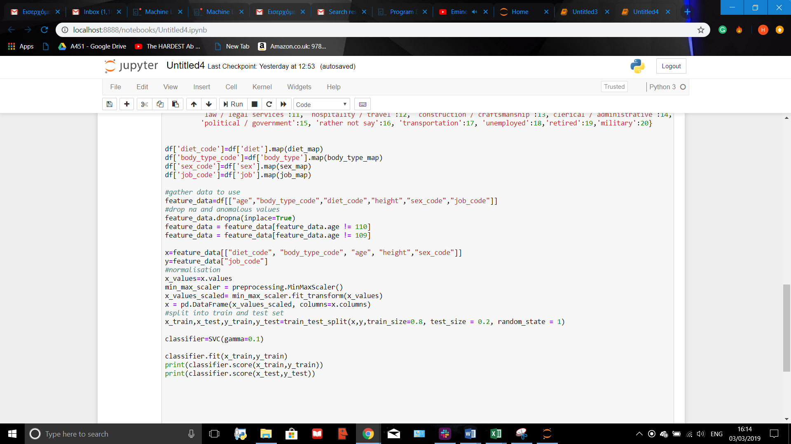
Question 3
Mapping and Making new columns

Slide 19
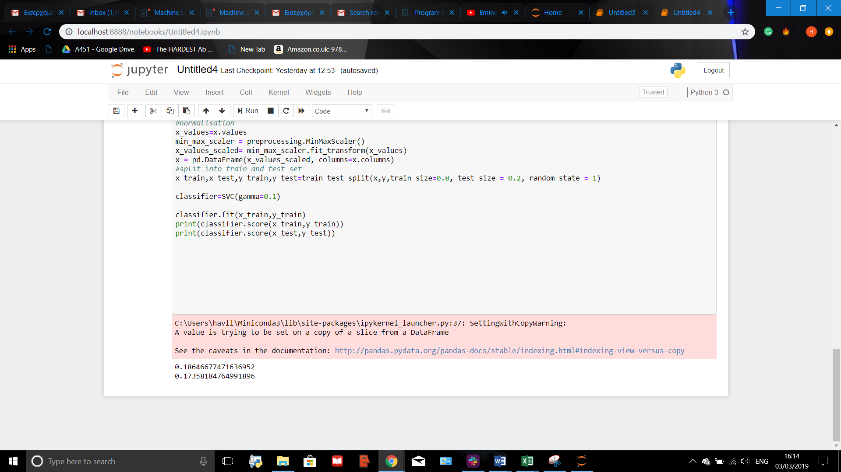
Question 3
Running the Model
Normalisation and splitting into train and test sets

Slide 20
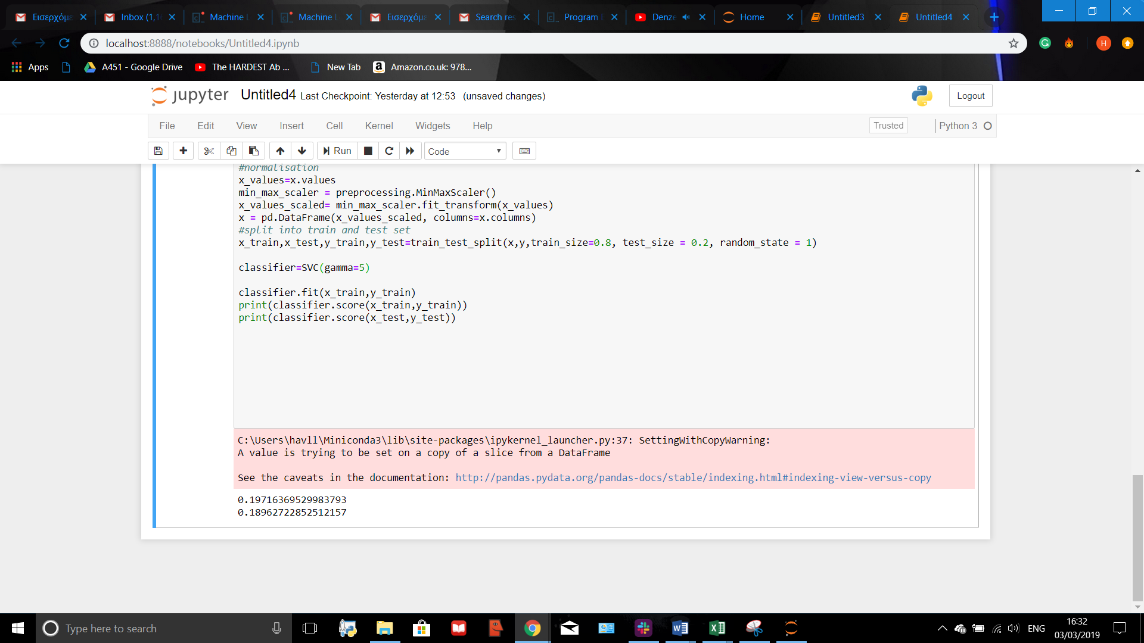


Trying out different values of gamma
Altering the gamma value will alter how lenient to error the model will be.
This will change the models accuracy.
Using trial and error, different values of gamma can be used until a value is found where the accuracy curve starts to converge. This will be the optimum gamma value.

Slide 21
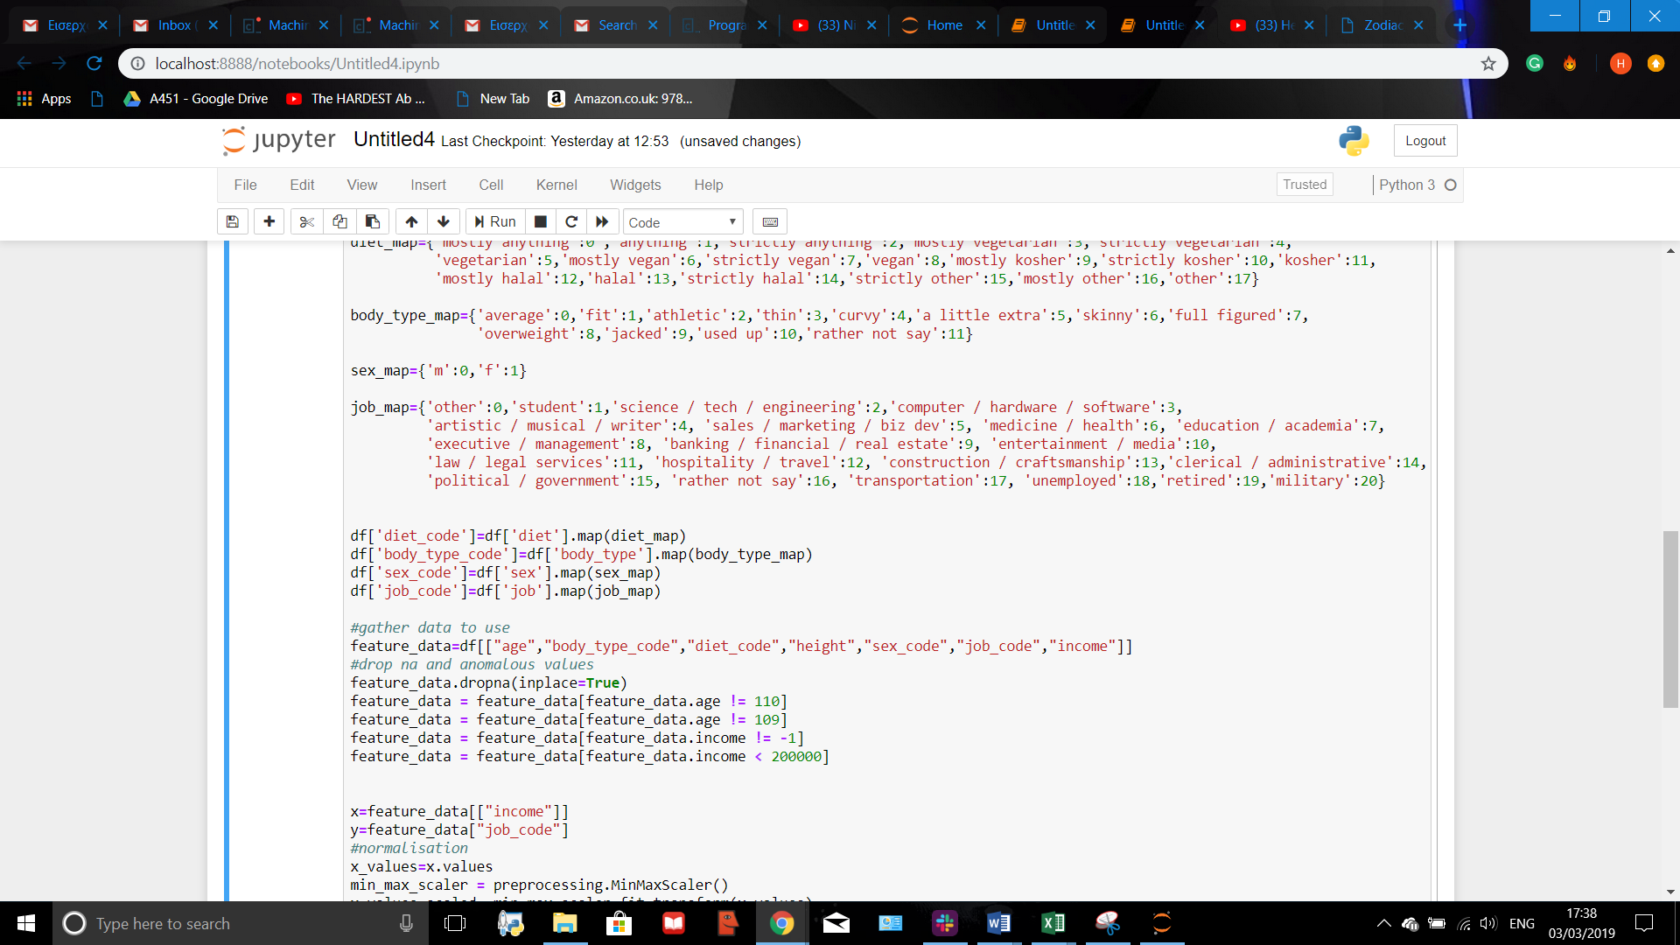
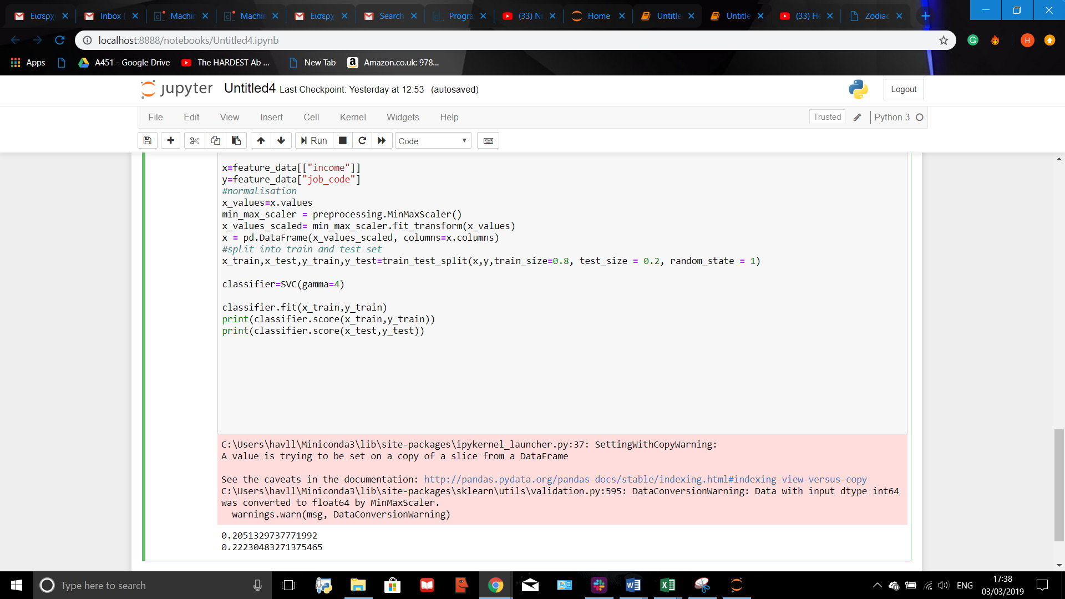
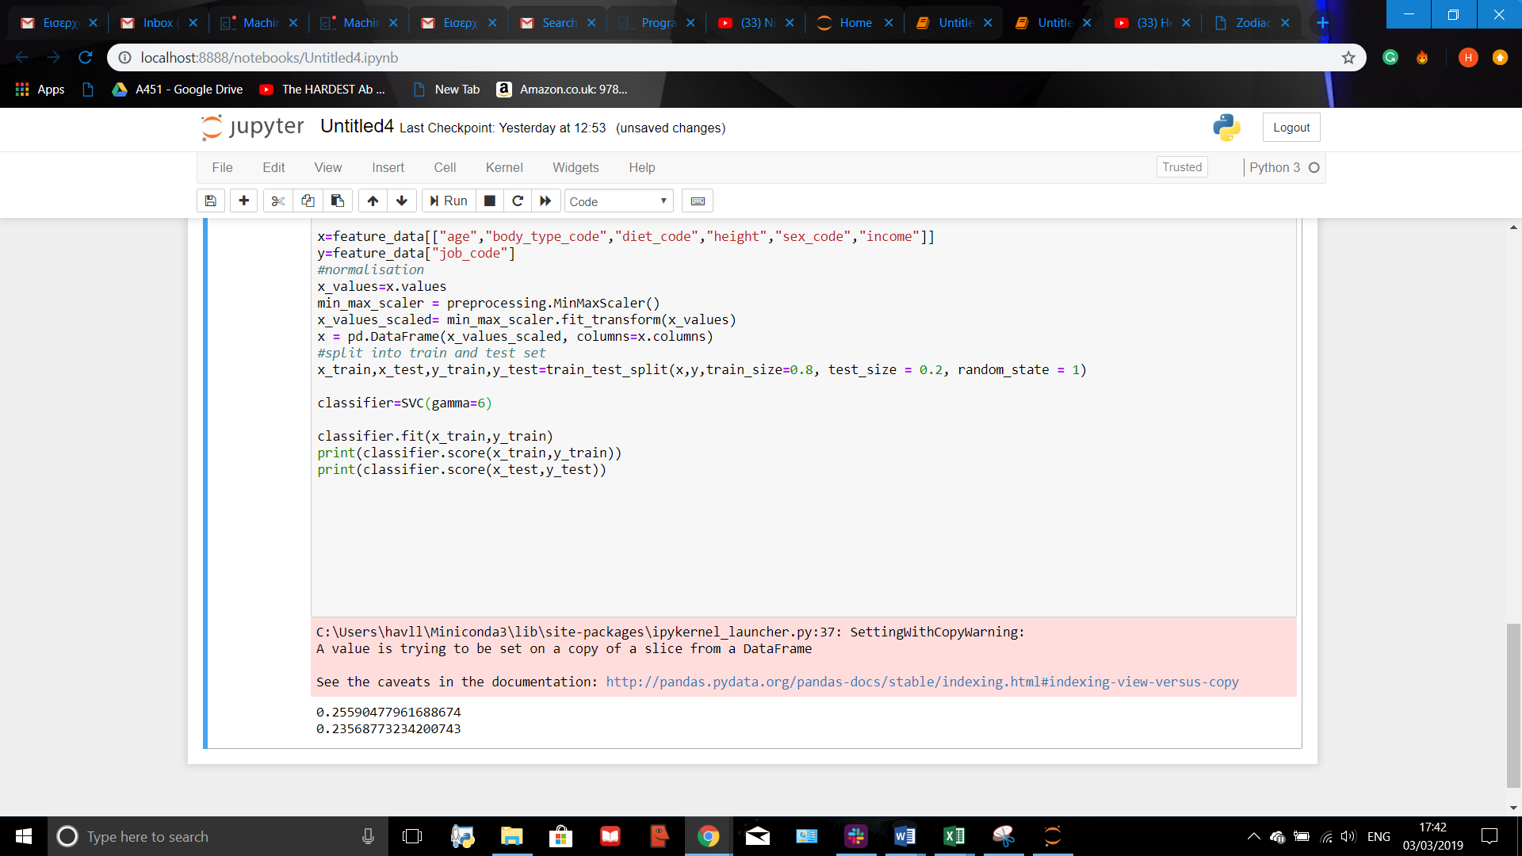
Adding a New Parameter
By adding further parameters to this model its accuracy could be added. ‘Income’, for example, would have a clear correlation with the job of an individual, and so could be used to make predictions more accurate.
Different gamma values will again have to be used to find the optimum value to use in the model.

Slide 22
Conclusion
This model worked successfully. Although it wasn’t very accurate, the results obtained where consistent and there was very little difference between the train and test R^2 values.
Possible sources of inaccuracy could be that some of the parameters used didn’t have a correlation with jobs whilst others did, unidentified anomalous results and suboptimum gamma values.
To make finding gamma more efficient, a graph between gamma values and validation accuracy could be produced, allowing for easy identification of the value of gamma for when the curve starts to converge.

Slide 23
Question 4
The Question
The Model
Does the length of the essays written by an individual have a correlation with there gender?
A K Nearest Neighbours Classifier will be used.

Slide 24
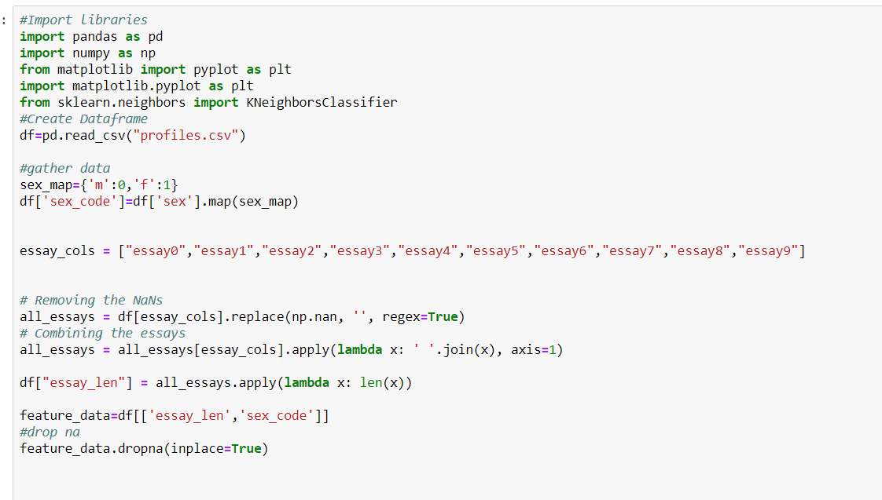
Making New Columns in the dataframe.
Two new columns will be made in order to run this model. One will be a numerical mapping of an individuals sex, called ‘sex_code’. The other one will be a column containing the length of all the essay answers of an individual joined together.
To obtain values for this column, all the essays will be joined together into one column first, then na values will be removed and then another column will contain the word length of each input in this one.

Slide 25
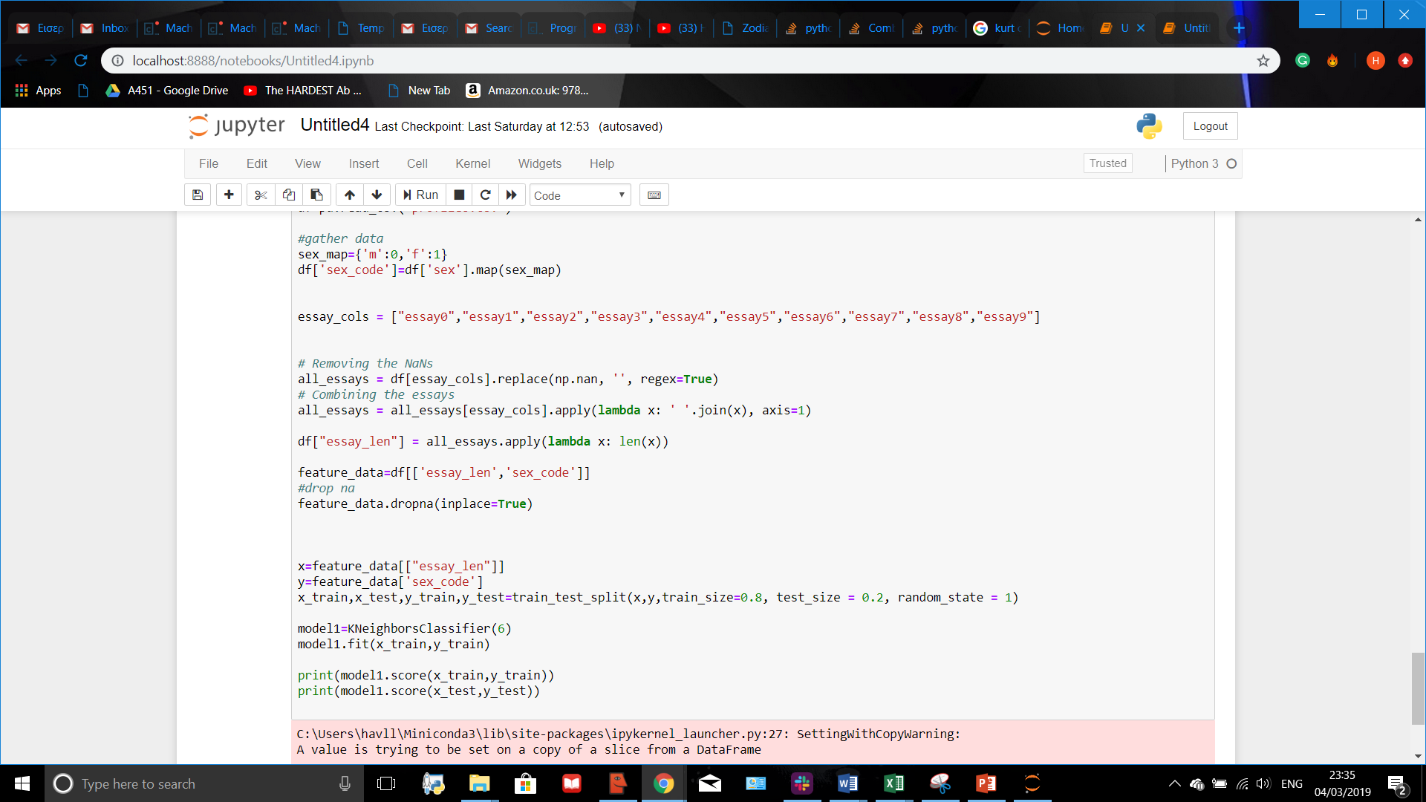
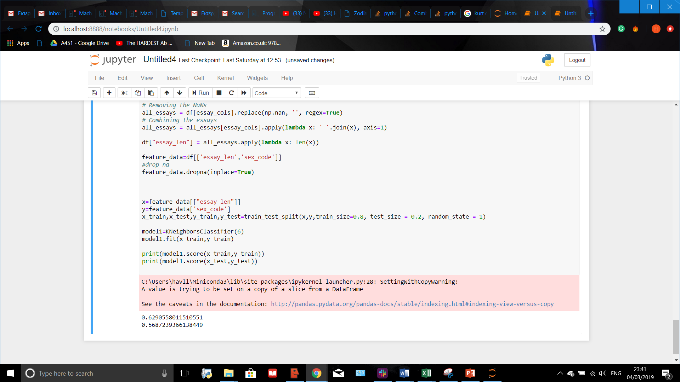
Question 4
Splitting into Train and Test Sets and Making Model
Different values for k where tested, and the one with the largest train and test R^2 values was used. This turned out to be k=6

Slide 26
Question 4-Conclusion
This model was very accurate. It was the most accurate one made in the project. This could be because the parameters were less varied and all of the same type, or because the correlation this model was representing was the clearest.
However, this model was the slowest to run, its runtime much longer than all the other models.
To improve this model, cross validation could be used to find the optimum value for k faster and more efficiently.

Slide 27
Machine Learning Final Project
By Harry Vellios, 17 year old student in the UK.

